Slide 1



Noida Institute of Engineering and Technology, Greater Noida
Network Layer
Unit: 3
Subject Name: Computer Networking
Subject Code: ACSE0602
Ms. Manisha
(Assistant Professor)
Computer Science
Department
Course B.Tech Semester 6th Sem
5/26/2024
1

Slide 2


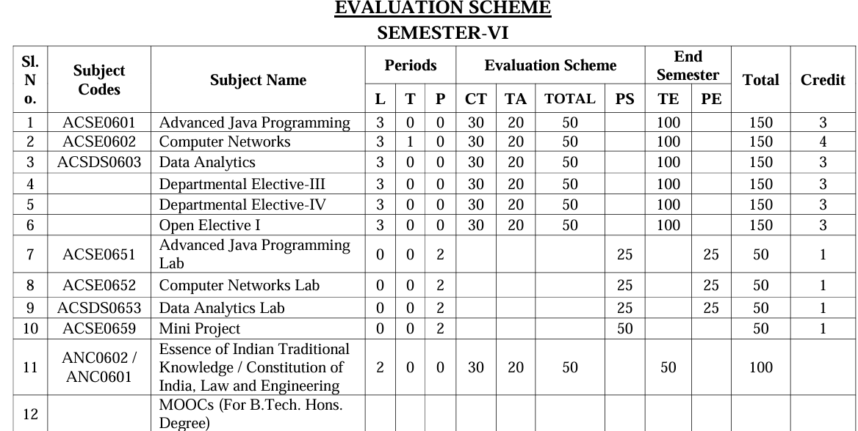
Curriculum
Faculty Name
Subject code and abbreviation
Unit Number
2

Slide 3
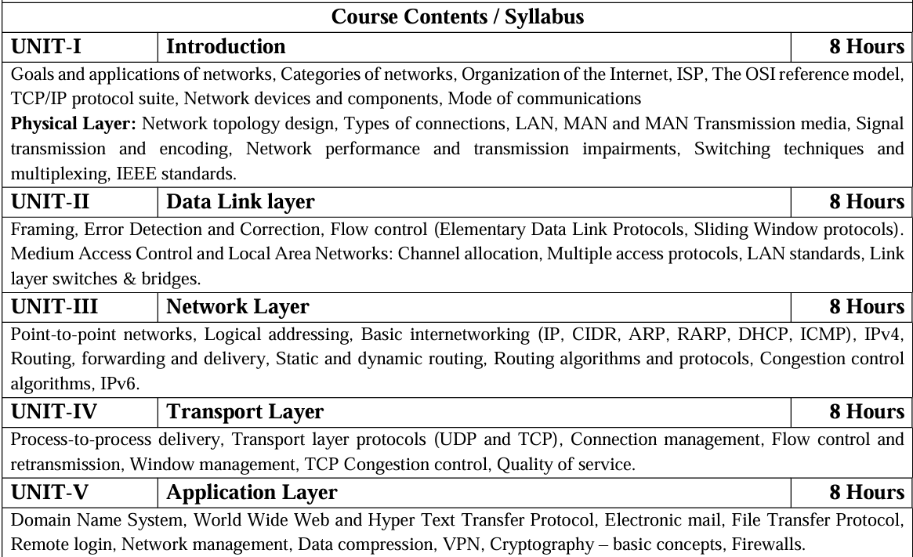
SYLLABUS
Faculty Name
Subject code and abbreviation
Unit Number
2

Slide 4
Books
Text books:
Behrouz Forouzan, “Data Communication and Networking” Fourth Edition-2006, Tata McGraw Hill
Andrew Tanenbaum “Computer Networks”, Fifth Edition-2011, Prentice Hall.
William Stallings, “Data and Computer Communication”, Eighth Edition-2008, Pearson.
Reference Books:
Kurose and Ross, “Computer Networking- A Top-Down Approach”, Eighth Edition-2021, Pearson.
Peterson and Davie, “Computer Networks: A Systems Approach”, Fourth Edition-1996, Morgan Kaufmann
Faculty Name
Subject code and abbreviation
Unit Number
2

Slide 5
Course Objective
The course objectives for a computer networks course are designed to ensure that students acquire a deep understanding of networking concepts and practical skills relevant to the field.
Understand fundamental networking concepts, terminology, and protocols. Recognize the significance of computer networks in modern technology. Understand the functionalities and protocols associated with each layer. Understand the roles of various network devices such as routers, switches, hubs, and access points. Learn about common network security threats and mitigation techniques. Understand encryption, firewalls, intrusion detection/prevention systems, and VPNs. Understand the impact of emerging technologies on network design and management.
Faculty Name
Subject code and abbreviation
Unit Number
2

Slide 6
Course Outcome
At the end of the course the student should be able to:
CO 1: Build an understanding of the fundamental concepts and Layered Architecture of computer networking.
CO 2:Understand the basic concepts of link layer properties to detect error and develop the solution for error control and flow control.
CO 3: Design, calculate, and apply subnet masks and addresses to fulfil networking requirements and calculate distance among routers in subnet.
CO 4: Understand the duties of transport layer, Session layer with connection management of TCP protocol.
CO 5: Discuss the different protocols used at application layer.
Faculty Name
Subject code and abbreviation
Unit Number
2

Slide 7
Program Outcomes
Engineering Knowledge:
Problem Analysis
Design/ Development of Solutions
Conduct
Modern Tool Usage
The Engineer and Society:
Environment and Sustainability:
Ethics:
Individual and Team Work
Communication
Project Management and Finance
Life-long Learning
Faculty Name
Subject code and abbreviation
Unit Number
2

Slide 8
PO CO Mapping
Computer Networks(KCS- 602) |  |  |  |  |  |  |  |  | Year of Study: 2023-24
CO | PO1 | PO2 | PO3 | PO4 | PO5 | PO6 | PO7 | PO8 | PO9 | PO10 | PO11 | PO12
KCS603 | 3 | 2 | 2 |  | 2 |  |  |  | 2 |  | 2 | 3
KCS603.2 | 3 | 3 | 2 |  |  |  |  |  |  |  |  | 3
KCS603.3 | 3 | 3 | 3 | 3 | 2 |  |  |  | 2 |  | 2 | 3
KCS603.4 | 3 | 2 | 2 |  | 2 |  |  |  |  |  |  | 3
KCS603.5 | 3 | 3 | 2 |  | 2 | 3 |  | 2 |  |  |  | 3
KCS603.6 | 3 | 2 | 2 |  | 2 | 2 | 2 | 2 |  | 2 | 2 | 3
Faculty Name
Subject code and abbreviation
Unit Number
2

Slide 9
PSO
Apply suitable techniques, modern tools to solve complex engineering problems in the field of computer science.
Design and optimize, ethical and innovative solutions for the betterment of the society.
Work as an individual or lead in a team with good communication and engage in life-long learning.
Faculty Name
Subject code and abbreviation
Unit Number
2

Slide 10
PSO Mapping
CO | PSO1 | PSO2 | PSO3 | PSO4
KCS602.1 | 2 | 2 | 2 | 2
KCS603.2 | 2 | 2 | 2 | 2
KCS603.3 | 2 | 2 | 2 | 3
KCS603.4 | 2 | 2 | 2 | 2
KCS603.5 | 2 | acse2 | 2 | 2
KCS606 | 2 | 2 | 2 | 2
Faculty Name
Subject code and abbreviation
Unit Number
2

Slide 11
Program Educational Objectives
PEO 1: To have an excellent scientific and engineering breadth so as to comprehend, analyze, design and provide sustainable solutions for real-life problems using state-of-the-art technologies.
PEO 2: To have a successful career in industries, to pursue higher studies or to support entrepreneurial endeavors and to face the global challenges.
PEO 3:To have an effective communication skills, professional attitude, ethical values and a desire to learn specific knowledge in emerging trends, technologies for research, innovation and product development and contribution to society.
PEO 4: To have life-long learning for up-skilling and re-skilling for successful professional career as engineer, scientist, entrepreneur and bureaucrat for betterment of society.
Faculty Name
Subject code and abbreviation
Unit Number
2

Slide 12
Result Analysis
Faculty Name
Subject code and abbreviation
Unit Number
2

Slide 13
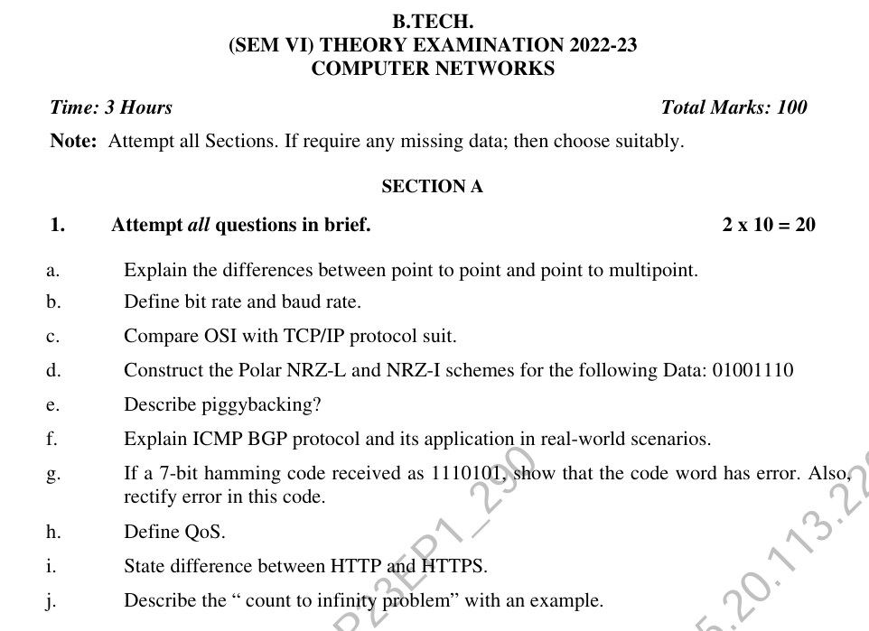
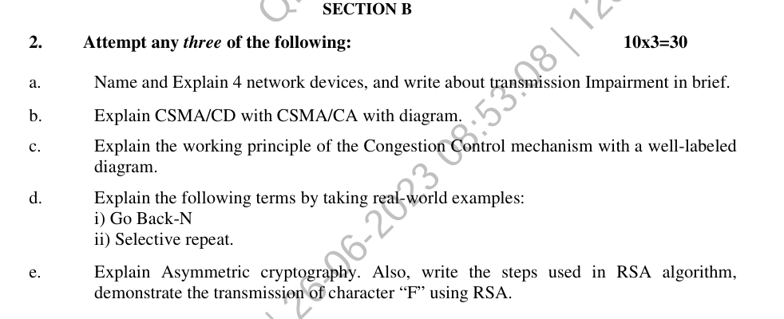
Previous Year Question Paper
Faculty Name
Subject code and abbreviation
Unit Number
2

Slide 14
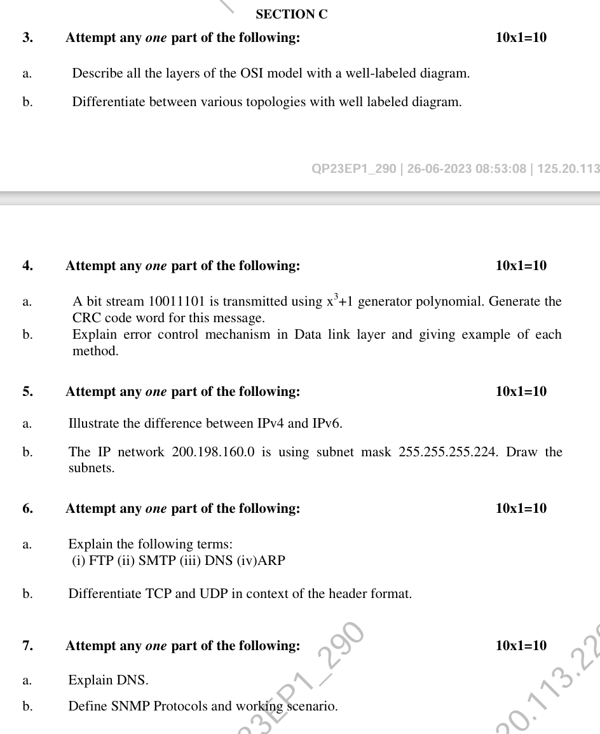
Previous Year Question Paper
Faculty Name
Subject code and abbreviation
Unit Number
2

Slide 15
Prerequisite and Recap
Networking components
Concept of physical addressing
Concept of OSI and TCP/IP model
In previous unit
Data link layer duties
Multi access protocol
Error control
Faculty Name
Subject code and abbreviation
Unit Number
2

Slide 16
Contents
Unit 3
Point-to-point networks
Logical addressing (IPv4)
Basic internetworking (IP, CIDR ARP, RARP, DHCP, ICMP)
Routing, forwarding and delivery
Static and dynamic routing
Routing algorithms and protocols
Congestion control algorithms
IPv6.
Faculty Name
Subject code and abbreviation
Unit Number
2

Slide 17
Network Layer Functions
Getting packets from the source all the way to the destination
May require many hops through intermediate routers.
It must know about the topology of the communication subnet ( the set of all routers) and choose appropriate paths through it.
It must take care to choose routers to avoid overloading some of the lines and routers while leaving others idle.
When source and destination are in different networks, it has to deal with the differences.
Faculty Name
Subject code and abbreviation
Unit Number
2

Slide 18
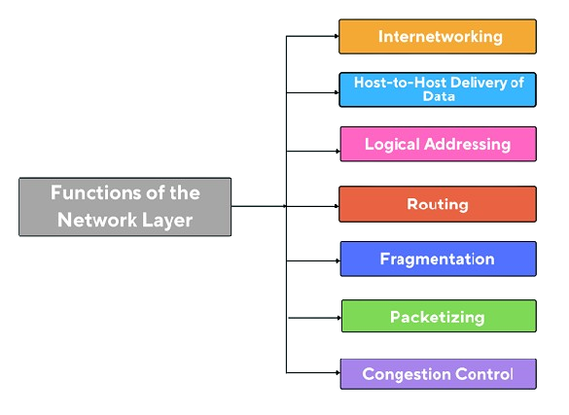
Network Layer Functions
Faculty Name
Subject code and abbreviation
Unit Number
2

Slide 19
Network Layer Functions
Faculty Name
Subject code and abbreviation
Unit Number
2

Slide 20
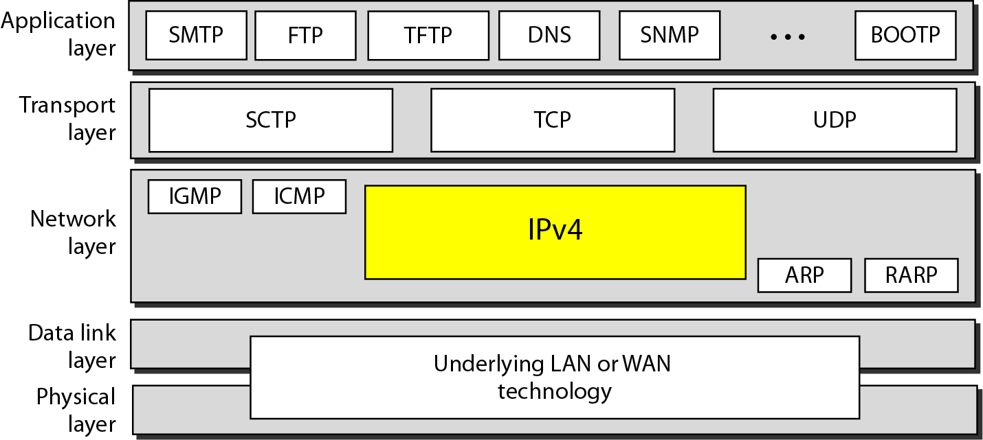
Network Layer Protocols
Faculty Name
Subject code and abbreviation
Unit Number
2

Slide 21
Network Layer Protocols
There are several network layer protocols in existence; however, only the following two are commonly implemented:
Internet Protocol version 4 (IPv4)
Internet Protocol version 6 (IPv6)
Other legacy network layer protocols that are not widely used include:
Novell Internetwork Packet Exchange (IPX)
AppleTalk Connectionless Network Service (CLNS/DEC Net)
Faculty Name
Subject code and abbreviation
Unit Number
2

Slide 22
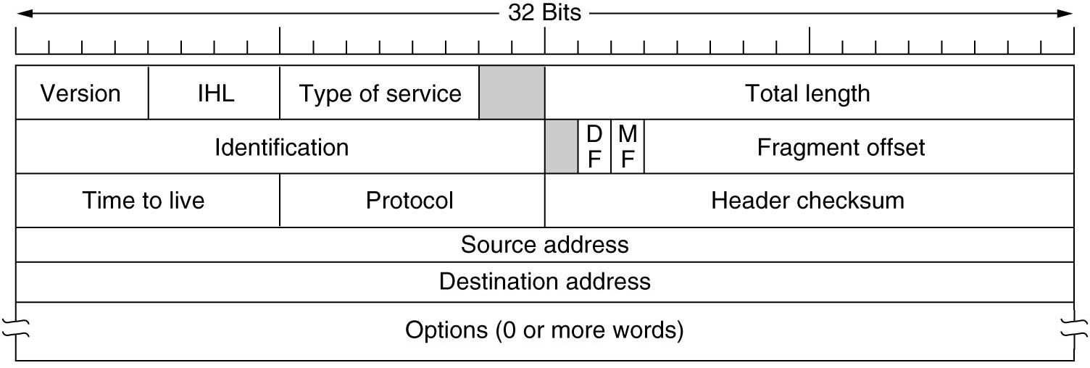
IPv4 Protocol
Faculty Name
Subject code and abbreviation
Unit Number
2

Slide 23
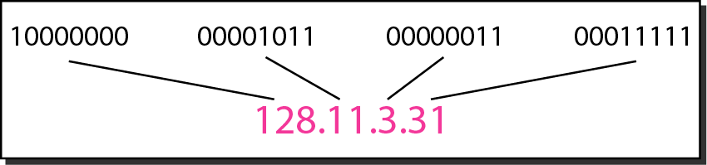
IPv4 Protocol
An IPv4 address is a 32-bit address that uniquely and universally defines the connection of a device (for example, a computer or a router) to the Internet.
An IPv4 address is a 32-bit address that uniquely and universally defines the connection of a device (for example, a computer or a router) to the Internet.
Dotted-decimal notation and binary notation for an IPv4 address
Faculty Name
Subject code and abbreviation
Unit Number
2

Slide 24
IPv4 Example
Change the following IPv4 addresses from binary notation to dotted-decimal notation.
Solution
We replace each group of 8 bits with its equivalent decimal number (see Appendix B) and add dots for separation.
Faculty Name
Subject code and abbreviation
Unit Number
2

Slide 25
IPv4 Example
Change the following IPv4 addresses from dotted-decimal notation to binary notation.
Solution
We replace each decimal number with its binary equivalent
Faculty Name
Subject code and abbreviation
Unit Number
2

Slide 26
IPv4 Example
Find the error, if any, in the following IPv4 addresses.
Solution
a. There must be no leading zero (045).
b. There can be no more than four numbers.
c. Each number needs to be less than or equal to 255.
d. A mixture of binary notation and dotted-decimal notation is not allowed.
Faculty Name
Subject code and abbreviation
Unit Number
2

Slide 27
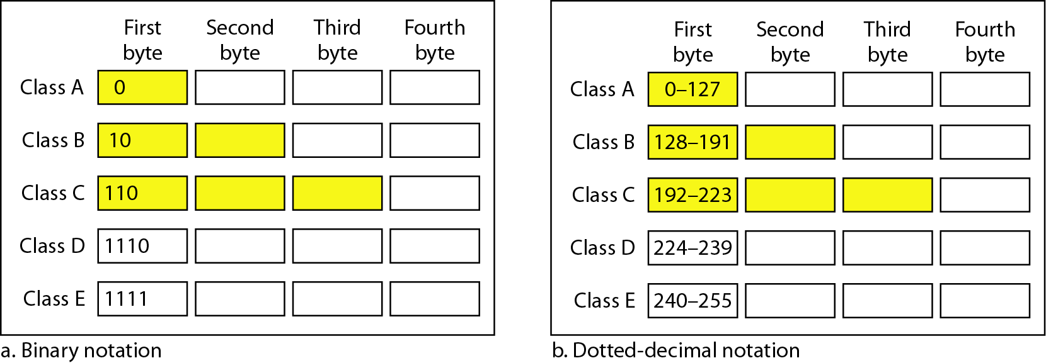
IPv4 address classification
Finding the classes in binary and dotted-decimal notation.
In classful addressing, the address space is divided into five classes:
A, B, C, D, and E.
Faculty Name
Subject code and abbreviation
Unit Number
2

Slide 28
IPv4 address classification
Find the class of each address.
a. 00000001 00001011 00001011 11101111
b. 11000001 10000011 00011011 11111111
c. 14.23.120.8
d. 252.5.15.111
Solution
a. The first bit is 0. This is a class A address.
b. The first 2 bits are 1; the third bit is 0. This is a class C address.
c. The first byte is 14; the class is A.
d. The first byte is 252; the class is E.
Faculty Name
Subject code and abbreviation
Unit Number
2

Slide 29
IPv4 address classification
IP: 201.99.89.115
Find Network Id and DBA?
To Find Net Id: IP (AND) Network Mask
Network Mask-
N id bits- make them all 1.
Hid bits- make them all 0.
Nid: 201.99.89.0
DBA: 201.99.89.255
Network Mask: 255.255.255.0
IP: 161.55.99.89
Find Network Id and DBA?
Faculty Name
Subject code and abbreviation
Unit Number
2

Slide 30
IPv4 address classification
Number of blocks and block size in classful IPv4 addressing
In classful addressing, a large part of the available addresses were wasted.
Default masks for class ful addressing
Faculty Name
Subject code and abbreviation
Unit Number
2

Slide 31
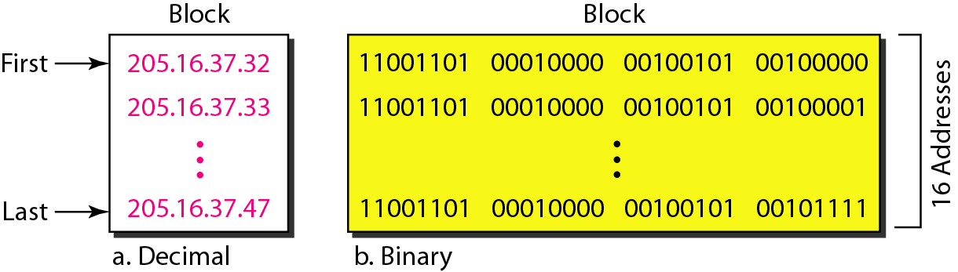
IPv4 address classification
A block of 16 addresses granted to a small organization
Classful addressing, which is almost obsolete, is replaced with classless addressing.
Faculty Name
Subject code and abbreviation
Unit Number
2

Slide 32
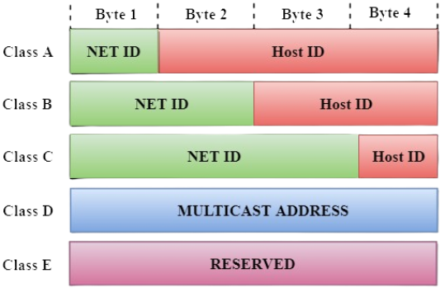
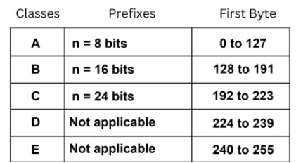
Classful Addressing
Classful addressing is a concept that divides the available address space of IPv4 into five classes namely A, B, C, D & E.
ip address is divided into two parts:
Network ID: It represents the number of networks.
Host ID: It represents the number of hosts.
Faculty Name
Subject code and abbreviation
Unit Number
2

Slide 33
Classful Addressing
How can we prove that we have 2,147,483,648 addresses in class A?
Solution
In class A, only 1 bit defines the class. The remaining 31 bits are available for the address. With 31 bits, we can have 231 or 2,147,483,648 addresses.
Find the class of the address: 00000001 00001011 00001011 11101111
Solution
The first bit is 0. This is a class A address.
Faculty Name
Subject code and abbreviation
Unit Number
2

Slide 34
Classful Addressing
The maximum number of networks that can use Class C addresses in the IPv4 addressing format is __________
2¹⁴
2⁷
2²¹
2²⁴
Faculty Name
Subject code and abbreviation
Unit Number
2

Slide 35
Classless Addressing
The Network address identifies a network on the internet. Using this, we can find a range of addresses in the network and total possible number of hosts in the network.
Mask is a 32-bit binary number that gives the network address in the address block when AND operation is bitwise applied on the mask and any IP address of the block.
Faculty Name
Subject code and abbreviation
Unit Number
2

Slide 36
Difference Between Classful Address and Classless Address
classless addressing is more beneficial and useful than classful addressing.
In classful addressing, the network ID and host ID are adjusted according to the classes. However, the distinction between network ID and host ID does not exist with classless addressing. This opens up the possibility of making yet another contrast between both addressing.
IP addresses are divided into five groups using the classful addressing approach when they are assigned. In order to prevent the depletion of IP addresses, classless addressing is used. It is a method of IP address allocation that will eventually replace classful addressing.
Faculty Name
Subject code and abbreviation
Unit Number
2

Slide 37
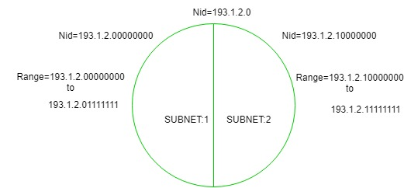
Subnetting
When a bigger network is divided into smaller networks, to maintain security, then that is known as Sub netting. So, maintenance is easier for smaller networks.
For example, if we consider a class A address, the possible number of hosts is 2²⁴ for each network, it is obvious that it is difficult to maintain such a huge number of hosts, but it would be quite easier to maintain if we divide the network into small parts.
The network can be divided into two parts: To divide a network into two parts, you need to choose one bit for each Subnet from the host ID part.
Faculty Name
Subject code and abbreviation
Unit Number
2

Slide 38
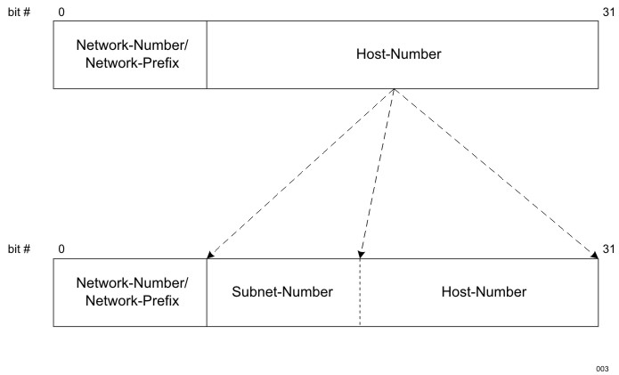
Subnetting
Subnet bits are borrowed from the host bits.
Faculty Name
Subject code and abbreviation
Unit Number
2

Slide 39
Subnetting
IP Address: 193.1.2.0
In class C the first 3 octets are network bits so it remains as it is.
For Subnet-1: The first bit which is chosen from the host id part is zero and the range will be from (193.1.2.00000000 till you get all 1’s in the host ID part i.e, 193.1.2.01111111) except for the first bit which is chosen zero for subnet id part.
Thus, the range of subnet 1 is: 193.1.2.0 to 193.1.2.127
Subnet id of Subnet-1 is : 193.1.2.0
The direct Broadcast id of Subnet-1 is: 193.1.2.127
The total number of hosts possible is: 126
(Out of 128, 2 id's are used for Subnet id & Direct Broadcast id)
The subnet mask of Subnet- 1 is: 255.255.255.128
Faculty Name
Subject code and abbreviation
Unit Number
2

Slide 40
Subnetting
For Subnet-2: The first bit chosen from the host id part is one and the range will be from (193.1.2.100000000 till you get all 1’s in the host ID part i.e, 193.1.2.11111111).
Thus, the range of subnet-2 is: 193.1.2.128 to 193.1.2.255
Subnet id of Subnet-2 is : 193.1.2.128
The direct Broadcast id of Subnet-2 is: 193.1.2.255
The total number of hosts possible is: 126
(Out of 128, 2 id's are used for Subnet id & Direct Broadcast id)
The subnet mask of Subnet- 2 is: 255.255.255.128
Faculty Name
Subject code and abbreviation
Unit Number
2

Slide 41
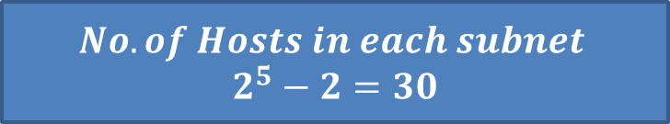
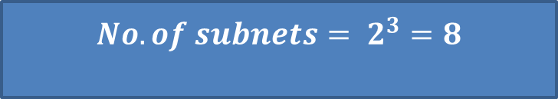
Subnetting
In class C, if Subnet Mask= 255.255.255.224
Find no. of subnets?
Find no. of hosts in each subnet?
Network Mask of class C= 255.255.255.0
11111111.11111111.11111111.00000000
11111111.11111111.11111111.11100000
$$No. of subnets= 2^{3}=8$$
Subnet bits
$$No. of Hosts in each subnet$$
$$2^{5}−2=30$$
Faculty Name
Subject code and abbreviation
Unit Number
2

Slide 42
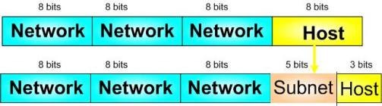

Subnetting
Let's use IP address 192.168.10.44 with subnet mask 255.255.255.248 or /29.
Step 1: Convert to Binary and Find Subnet Address
Step 2: Find Host Range
Faculty Name
Subject code and abbreviation
Unit Number
2

Slide 43
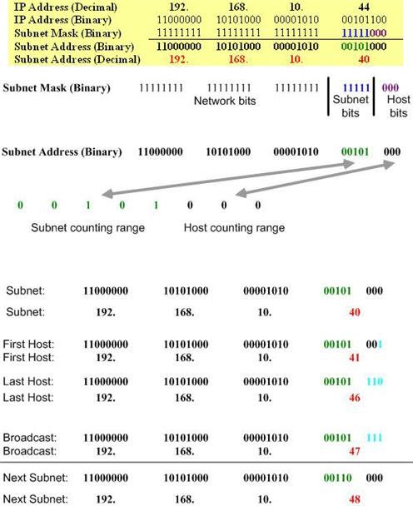
Subnetting
Faculty Name
Subject code and abbreviation
Unit Number
2

Slide 44
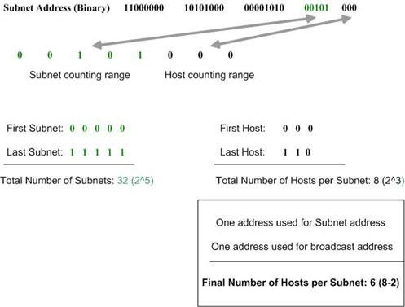
Subnetting
Step 3: Calculate the Total Number of Subnets and Hosts Per Subnet
Faculty Name
Subject code and abbreviation
Unit Number
2

Slide 45
CIDR Notation
CIDR (Classless Inter-Domain Routing) notation is a compact way to represent IP address ranges and subnet masks.
CIDR notation consists of an IP address followed by a forward slash ("/") and a number, which represents the prefix length or subnet mask. Here's how CIDR notation works:
IP Address: This is the starting address of the network or subnet you want to represent. It's typically written in decimal format with four octets (e.g., 192.168.1.0).
Forward Slash ("/"): This character separates the IP address from the prefix length or subnet mask.
Prefix Length or Subnet Mask: The number following the forward slash indicates how many bits of the IP address are used for the network portion.
In CIDR notation, this is represented as the number of bits set to '1' in the subnet mask. For example, /24 means the first 24 bits are for the network portion, and the remaining bits are for host addresses.
Faculty Name
Subject code and abbreviation
Unit Number
2

Slide 46
CIDR Notation
Here are some examples of CIDR notation:
192.168.1.0/24: This represents a network with a subnet mask of 255.255.255.0, where the first 24 bits are for the network, and the last 8 bits are for host addresses.
10.0.0.0/16: This represents a network with a subnet mask of 255.255.0.0, where the first 16 bits are for the network, and the remaining 16 bits are for host addresses.
172.16.0.0/12: This represents a network with a subnet mask of 255.240.0.0, where the first 12 bits are for the network, and the remaining 20 bits are for host addresses
Faculty Name
Subject code and abbreviation
Unit Number
2

Slide 47
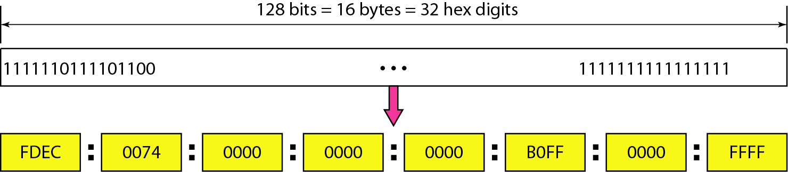
IPv6
Objective: Study about basic concept of IPv6 and its function
Despite all short-term solutions, address depletion is still a long-term problem for the Internet. This and other problems in the IP protocol itself have been the motivation for IPv6
An IPv6 address is 128 bits long.
Faculty Name
Subject code and abbreviation
Unit Number
2

Slide 48
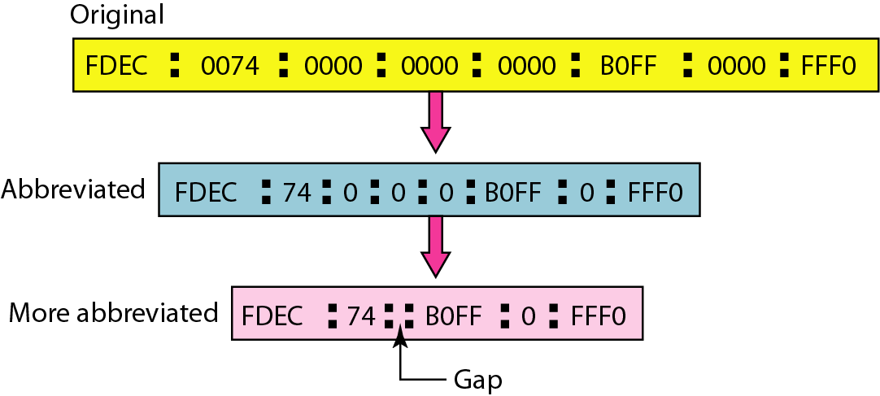
IPv6
IPv6 address in binary and hexadecimal colon notation
Faculty Name
Subject code and abbreviation
Unit Number
2

Slide 49
IPv6 Address
Expand the address 0:15::1:12:1213 to its original.
Solution
We first need to align the left side of the double colon to the left of the original pattern and the right side of the double colon to the right of the original pattern to find how many 0s we need to replace the double colon.
This means that the original address is.
Faculty Name
Subject code and abbreviation
Unit Number
2

Slide 50
IPv6 Address
IPv6 address in binary and hexadecimal colon notation
Faculty Name
Subject code and abbreviation
Unit Number
2

Slide 51
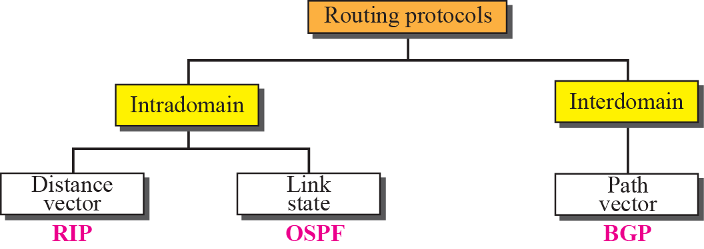
IPv6 Address
Faculty Name
Subject code and abbreviation
Unit Number
2

Slide 52
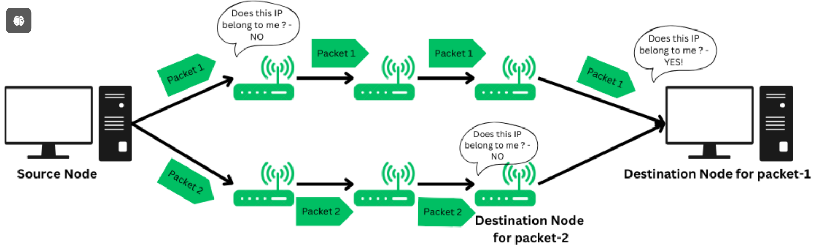
Routing
Routing refers to the process of directing a data packet from one node to another. It is an autonomous process handled by the network devices to direct a data packet to its intended destination. Note that, the node here refers to a network device called – ‘Router‘.
Faculty Name
Subject code and abbreviation
Unit Number
2

Slide 53
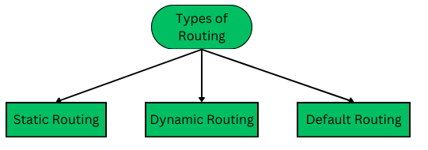
Type of Routing
1. Static Routing
Static routing is also called as “non-adaptive routing”. In this, routing configuration is done manually by the network administrator.
2. Dynamic Routing
Dynamic Routing is another type of routing in which routing is an autonomous procedure without any human intervention. Packets are transmitted over a network using various shortest path algorithms and pre-determined metrics.
Faculty Name
Subject code and abbreviation
Unit Number
2

Slide 54
Type of Routing
3. Routing Table
Routing table is a logical data structure used to store the IP addresses and relevant information regarding the nearest routers. The source node then looks up for the IP addresses of all the nodes that can transmit the packet to its destination and selects the shortest path using the shortest path algorithm and then routes accordingly.
Routing Table is stored in a router, a network device that determines the shortest path and routes the data packet.
Faculty Name
Subject code and abbreviation
Unit Number
2

Slide 55
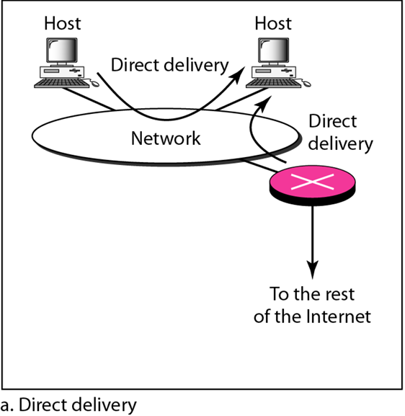
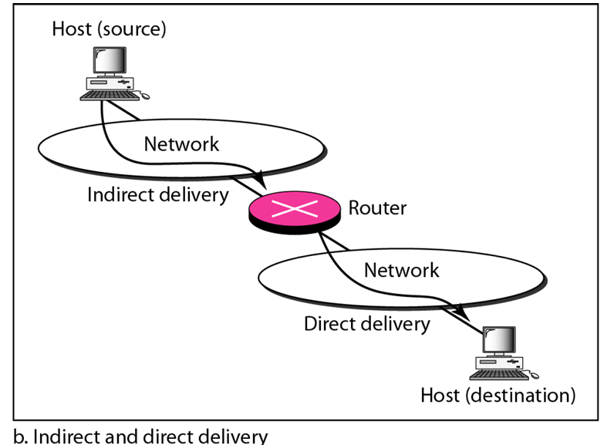
Routing
Routers are used on the network for forwarding a packet from the local network to the remote network. So, the process of routing involves the packet forwarding from an entry interface out to an exit interface.
The network layer supervises the handling of the The network layer supervises the handling of the packets by the underlying physical networks. We define this handling as the delivery of a packet.
Faculty Name
Subject code and abbreviation
Unit Number
2

Slide 56
Routing
Forwarding means to place the packet in its route to its destination. Forwarding requires a host or a router to have a routing table. When a host has a packet to send or when a router has received a packet to be forwarded, it looks at this table to find the route to the final destination.
Forwarding Techniques
Next-Hop method versus Route Method
Network-specific Method versus Host-specific Method
Default Method
Faculty Name
Subject code and abbreviation
Unit Number
2

Slide 57
Distance Vector Routing Algorithm
Step-01:
Each router prepares its routing table. By their local knowledge. each router knows about-
All the routers present in the network
Distance to its neighboring routers
Step-02:
Each router exchanges its distance vector with its neighboring routers.
Each router prepares a new routing table using the distance vectors it has obtained from its neighbors.
This step is repeated for (n-2) times if there are n routers in the network.
After this, routing tables converge / become stable.
Faculty Name
Subject code and abbreviation
Unit Number
2

Slide 58
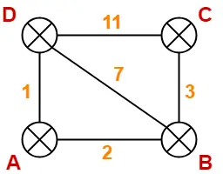
Distance Vector Routing Algorithm
Consider-
There is a network consisting of 4 routers.
The weights are mentioned on the edges.
Weights could be distances or costs or delays.
Step 1: Each router prepares its routing table using its local knowledge.
Routing table prepared by each router is shown below-
Faculty Name
Subject code and abbreviation
Unit Number
2

Slide 59
Distance Vector Routing Algorithm
Dest | Cost | Next hop
A | 0 | -/A
B | 2 | -/B
C | Inf | -
D | 1 | -/D
Dest | Cost | Next hop
A | Inf | -
B | 3 | B
C | 0 | C
D | 11 | D
Dest | Cost | Next hop
A | 2 | A
B | 0 | B
C | 3 | C
D | 7 | D
Dest | Cost | Next hop
A | 1 | A
B | 7 | B
C | 11 | C
D | 0 | D
Faculty Name
Subject code and abbreviation
Unit Number
2

Slide 60
Distance Vector Routing Algorithm
Step 2:
Each router exchanges its distance vector obtained in Step-01 with its neighbors.
After exchanging the distance vectors, each router prepares a new routing table.
Faculty Name
Subject code and abbreviation
Unit Number
2

Slide 61
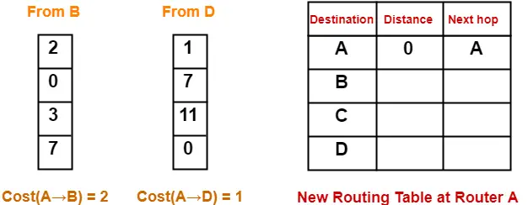
AT Router A
Cost of reaching destination B from router A
min { 2+0 , 1+7 } = 2 via B.
Cost of reaching destination C from router A
min { 2+3 , 1+11 } = 5 via B.
Cost of reaching destination D from router A
min { 2+7 , 1+0 } = 1 via D.
Dest | Cost | Next Hop
A | 2 | A
B | 2 | B
C | 5 | B
D | 1 | D
Faculty Name
Subject code and abbreviation
Unit Number
2

Slide 62
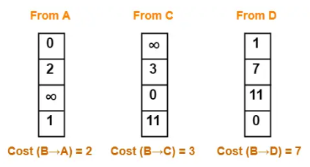
AT Router B
Cost of reaching destination A from router B
min { 2+0 , 3+∞ , 7+1 } = 2 via A.
Cost of reaching destination C from router B
min { 2+∞ , 3+0 , 7+11 } = 3 via C.
Cost of reaching destination D from router B
min { 2+1 , 3+11 , 7+0 } = 3 via A.
Dest | Cost | Next Hop
A | 2 | A
B | 0 | B
C | 3 | C
D | 3 | A
Faculty Name
Subject code and abbreviation
Unit Number
2

Slide 63
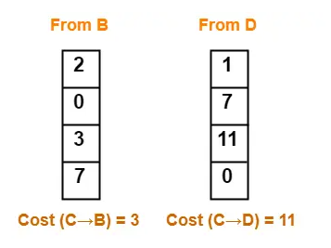
AT Router C
Cost of reaching destination A from router C
min { 3+2 , 11+1 } = 5 via B.
Cost of reaching destination B from router C
min { 3+0 , 11+7 } = 3 via B.
Cost of reaching destination D from router C min { 3+7 , 11+0 } = 10 via B.
Dest | Cost | Next Hop
A | 5 | B
B | 3 | B
C | 0 | C
D | 10 | B
Faculty Name
Subject code and abbreviation
Unit Number
2

Slide 64
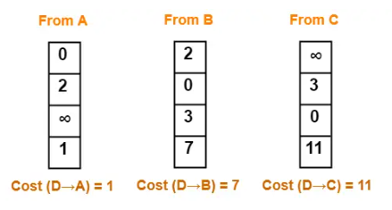
AT Router D
Cost of reaching destination A from router D
min { 1+0 , 7+2 , 11+∞ } = 1 via A.
Cost of reaching destination B from router D min { 1+2 , 7+0 , 11+3 } = 3 via A.
Cost of reaching destination C from router D min { 1+∞ , 7+3 , 11+0 } = 10 via B.
Dest | Cost | Next Hop
A | 1 | A
B | 3 | A
C | 10 | B
D | 0 | D
Faculty Name
Subject code and abbreviation
Unit Number
2

Slide 65
Router
Step 3:
Each router exchanges its distance vector obtained in Step-02 with its neighbors.
After exchanging the distance vectors, each router prepares a new routing table.
Faculty Name
Subject code and abbreviation
Unit Number
2

Slide 66
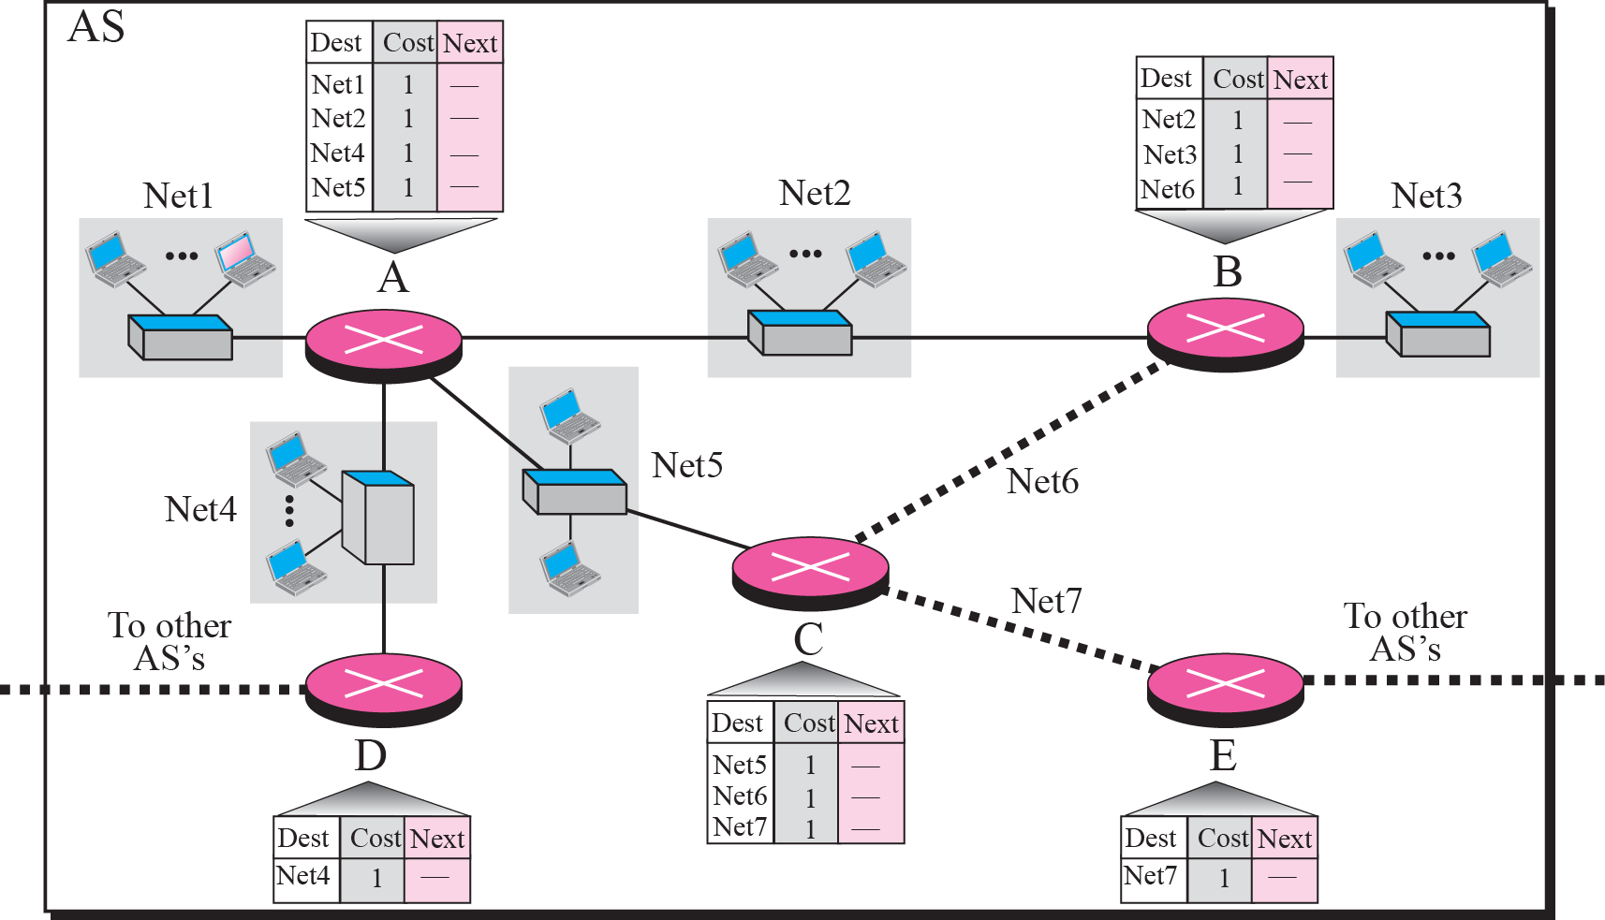
Router
Figure shows the initial routing table for an AS. Note that the figure does not mean that all routing tables have been created at the same time; each router creates its own routing table when it is booted.
Faculty Name
Subject code and abbreviation
Unit Number
2

Slide 67
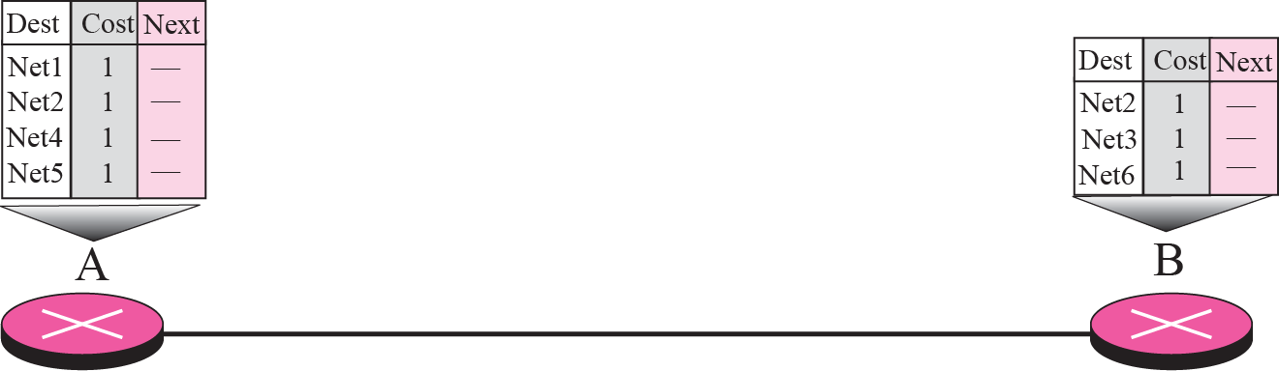
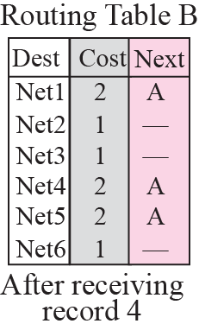
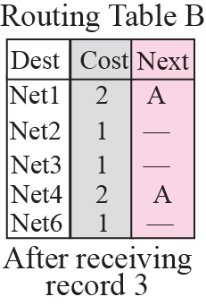
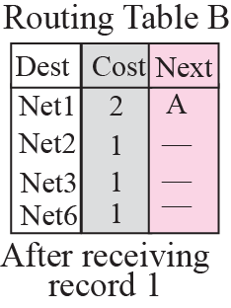
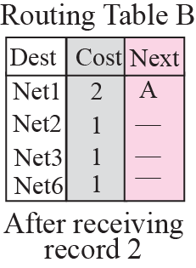
Router
Now assume router A sends four records to its neighbors, routers B, D, and C. shows the changes in B’s routing table when it receives these records.
Faculty Name
Subject code and abbreviation
Unit Number
2

Slide 68
Congestion control Algorithm
Congestion control refers to the techniques used to control or prevent congestion. Congestion control techniques can be broadly classified into two categories:
Open Loop Congestion Control
Open loop congestion control policies are applied to prevent congestion before it happens. The congestion control is handled either by the source or the destination.
Policies adopted by open loop congestion control –
Retransmission Policy :
Window Policy
Discarding Policy
Acknowledgment Policy
Admission Policy
Faculty Name
Subject code and abbreviation
Unit Number
2

Slide 69
Congestion control Algorithm
Closed Loop Congestion Control
Closed loop congestion control techniques are used to treat or alleviate congestion after it happens. Several techniques are used by different protocols.
Backpressure
Choke Packet Technique
Implicit Signalling
Explicit Signalling
Faculty Name
Subject code and abbreviation
Unit Number
2

Slide 70
Recourse Link
You tube/other Video Links
https://www.youtube.com/watch?v=aqtd8iZlSAA
https://www.youtube.com/watch?v=JhBnOamc_8s
https://youtu.be/rW1jPlYgp_0?si=wyA5HLfnkWZaOlnv
NPTEL :: Computer Science and Engineering - NOC:Computer Networks and Internet Protocol
Faculty Name
Subject code and abbreviation
Unit Number
2

Slide 71
Daily Quiz
The Data Link Layer in the OSI model is divided into two sublayers. What are they?
A. MAC and LLC
B. TCP and IP
C. HTTP and FTP
D. Physical and Logical
Which of the following protocols operates at the Application Layer of the OSI model?
A. FTP
B. IP
C. ICMP
D. ARP
Which of the following protocols operates at the Network Layer?
A. TCP
B. IP
C. FTP
D. HTTP
Which device operates primarily at the Network Layer?
A. Switch
B. Router
C. Hub
D. Bridge
Faculty Name
Subject code and abbreviation
Unit Number
2

Slide 72
Daily Quiz
True/False Questions:
The Internet Layer in the TCP/IP model is responsible for routing packets across network boundaries. (True/False)
The Presentation Layer in the OSI model ensures that data is presented in a readable format between different systems. (True/False)
TCP is a connectionless protocol used for fast transmission of data with no guarantee of delivery. (True/False)
The Data Link Layer in the OSI model is responsible for logical addressing. (True/False)
HTTP operates at the Transport Layer in the OSI model. (True/False)
True/False:
True
True
False
False
False
Faculty Name
Subject code and abbreviation
Unit Number
2

Slide 73
Daily Quiz
Network
Presentation
HTTP
TCP, UDP
Application
Fill in the Blanks:
The _________ layer of the OSI model is responsible for packet forwarding including routing through intermediate routers.
In the OSI model, the _________ layer is concerned with the syntax and semantics of the information transmitted.
The protocol used by web browsers to retrieve web pages is _________.
The Transport Layer in the TCP/IP model can use either _________ or _________ protocols for data transmission.
The _________ layer in the OSI model is where end-user network applications operate.
Network
Presentation
HTTP
TCP, UDP
Application
Faculty Name
Subject code and abbreviation
Unit Number
2

Slide 74
Expected Questions for University Exam
Compare routers and gateways. (CO4)
Write the IP address range of each class. (CO4)
3. Explain the need of subnet. (CO4)
4. Write acronym for ARP, RARP, ICMP(CO4)
For the given IP address 192.168.2.9 find the class, network address and host address. (CO4)
Write down default mask for each class IP address. (CO4)
Write down subnet mask for given 192.12.3.9/26 IP address. (CO4)
List the functions of network layer. (CO4)
Faculty Name
Subject code and abbreviation
Unit Number
2

Slide 75
References
Books:
Forouzen, "Data Communication and Networking",TMH
A.S. Tanenbaum, Computer Networks, Pearson Education
W. Stallings, Data and Computer Communication, MacmillanPress
Faculty Name
Subject code and abbreviation
Unit Number
2

